Slide 1
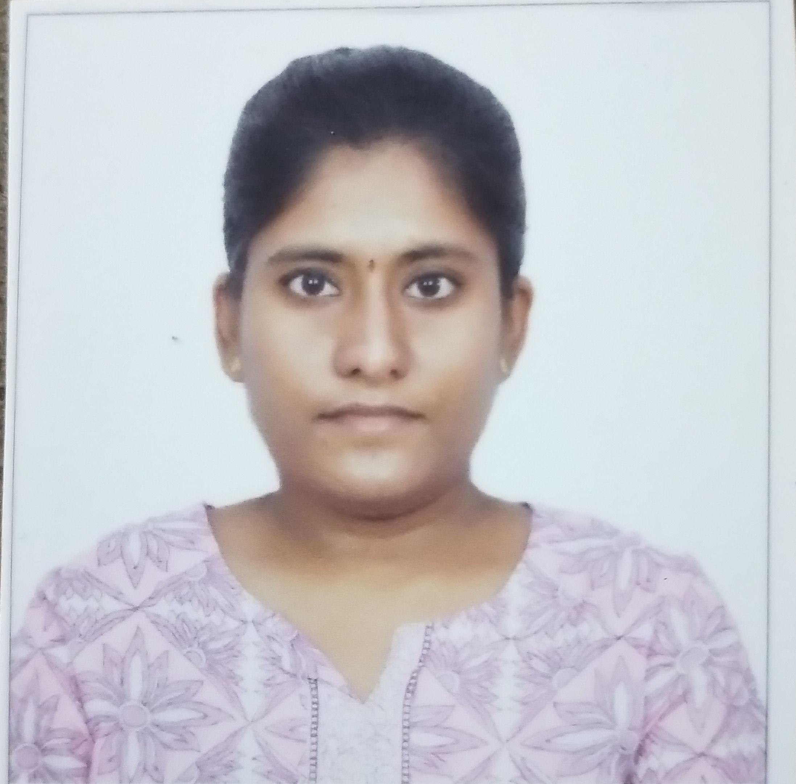

Parnapalli Sahithya
Analyst/Software Engineer
Master of Technlogy, Electrical and Electronics Engineering : 2019 - 2021
Skills
Java​ | Java Basics,OOPS,Generics,​ Collections, Array, Loops​
Spring | Spring Boot, Spring Rest Services, Spring Restful Services
React​ | Components, Hooks, Virtual DOM, Routing, Forms & Validation​
Database​ | Postgre SQL
UI Tech​ | HTML 5 & CSS, Bootstrap 4, JavaScript, ES6
Tools | Eclipse, STS, GitHub, Postman, Swagger, Sonarlint, Visual Studio Code, Pg Admin 4, SQL Shell
Add On skills​ ​ | Immersive Learning​
Mumbai
parnapalli.sahithya@capgemini.com
9948897142
A4
Full Stack Developer
Hands on experience on Core Java, Postgre Sql, Spring Restful Services
Proficient in creating Single page Web Application in React with Authentication with routing
Hands on experience in developing web pages using HTML5, CSS, Object TypeScript, Good understanding of Document Object Model (DOM) and DOM Functions
Ready to learn new technologies and implement them for the future knowledge improvement.
E-Vehicle Showroom Admin and Dealer page
Case study of e- Vehicle showroom for admin and dealer pages along with API Gateway, Swagger, responsive UI with HTML5, CSS, Bootstrap and React used as User Interface.
Degreed :Successfully completed the degreed training in GIT, HTML, CSS, SQL, React.
Check out my work on GitHub

